Slide 1
MODULE-6 CO-PROCESSOR

Slide 2
INTRODUCTION
General-purpose microprocessors have an upper limit of data-processing capability and it require complex programming to perform any mathematical calculations.
To increase the operating speed, several microprocessors are connected together using a certain network topology. Then the system is called a multiprocessor system.
The simplest multiprocessors system consists of a microprocessor and a Numeric Data Processor (NDP)
NDP is also called as Math Co-processor or Floating point unit or Numeric processor extension.
The numeric data processor is an independent math processing unit and it can do complex numeric calculations very fast compared to the main processor.
The most commonly used numeric processors are 8087, 80287 and 80387.

Slide 3
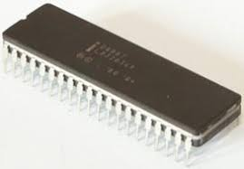
INTRODUCTION TO 8087
8087 was the first math coprocessor for 16-bit processors designed by Intel
Packed in 40 pin DIP package, available in 5MHz, 8MHz and 10 MHz versions compatible with 8086 and 8088.
The purpose of 8087 was to speed up the computations involving floating point calculations.
Addition, subtraction, multiplication and division of simple numbers is not the coprocessor’s job.
It does all the calculations involving floating point numbers like scientific calculations and algebraic functions.

Slide 4
INTRODUCTION TO 8087
By having a coprocessor, which performs all the calculations, it can free up a lot of CPU’s time.
This would allow the CPU to focus all of its resources on the other functions it has to perform.
This increases the overall speed and performance of the entire system.
This coprocessor introduced about 60 new instructions available to the programmer.
All the mnemonics begin with “F” to differentiate them from the standard 8086 instructions.
For e.g.: in contrast to ADD/MUL, 8087 provide FADD/FMUL

Slide 5
ARCHITECTURE OF 8087
8087 coprocessor is designed to operate with 8086 microprocessor.
The microprocessor and coprocessor can execute their respective instructions simultaneously.
Microprocessor interprets and executes the normal instruction set and the coprocessor interprets and executes only the coprocessor instructions.

Slide 6
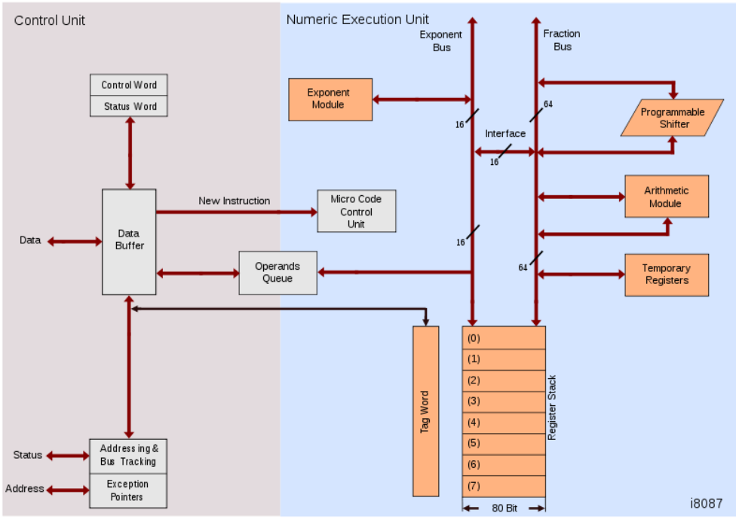
ARCHITECTURE OF 8087

Slide 7
ARCHITECTURE OF 8087
The internal structure of 8087 coprocessor is divided into two major sections:
▪ Control Unit (CU)
▪ Numerical Execution Unit (NEU)

Slide 8
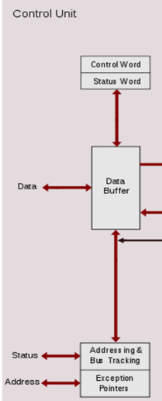
CONTROL UNIT
It is used to synchronize the operation of the coprocessor and the microprocessor.
This unit has a Control Word, Status Word and Data Buffer.
receives and decodes the instructional opcode and reads or writes operands from memory
If an instruction is ESC instruction, then coprocessor executes it.
If not, then microprocessor executes

Slide 9
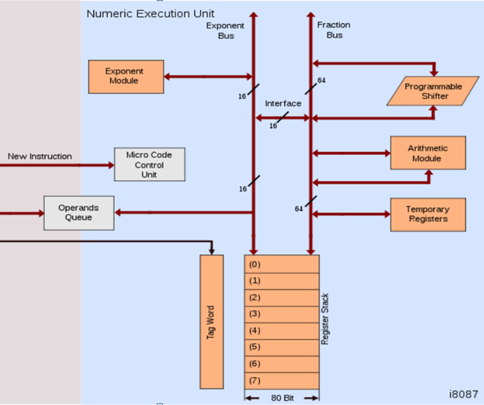
NUMERIC EXECUTION UNIT
This unit is responsible for executing all coprocessor instructions.
It has an 8 register stack that holds the operands for instructions and result of instructions.
The stack contains 8 registers that are 80-bits wide.
Numeric data is transferred inside the coprocessor in two parts:
64-bit mantissa bus
16-bit exponent bus

Slide 10
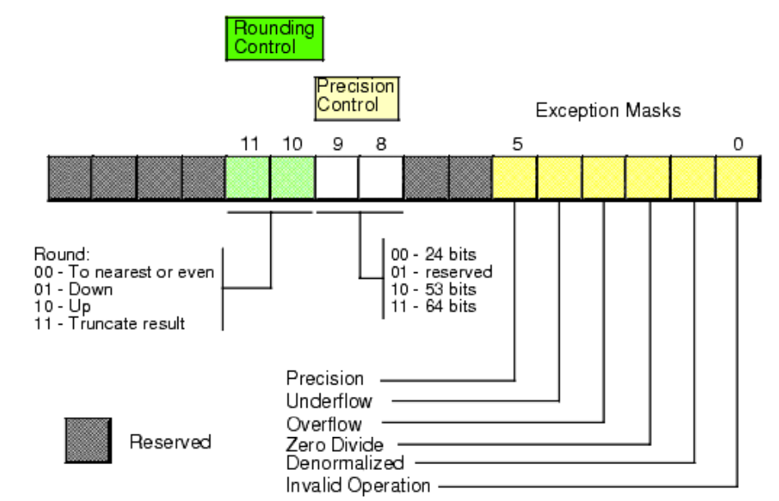
CONTROL WORD REGISTER

Slide 11
CONTROL WORD REGISTER
Control Register controls the operating modes of 8087.
It is also a 16-bit register.
It performs rounding control and precision control.
It is also used to do masking and unmasking of the exception bits that correspond to the rightmost six bits of the status register.
FLDCW instruction is used to load the value into control register

Slide 12

CONTROL WORD REGISTER
Rounding Control: It determines the type of rounding or truncating to be done.
00=Round to nearest or even
01=Round down towards minus infinity
10=Round up towards plus infinity
11=Chop or truncate towards zero
Precision Control:
It sets the precision of the result.
00=Single precision (short)
01=Reserved
10=Double precision (long)
11=Extended precision (temporary)
Exception Masks: It determines that whether an error effects the exception bits in the status register.
If it is one, then the corresponding error is ignored.
If it is zero and the corresponding error occurs, then it generates an interrupt, and the corresponding bit in status register is set.

Slide 13
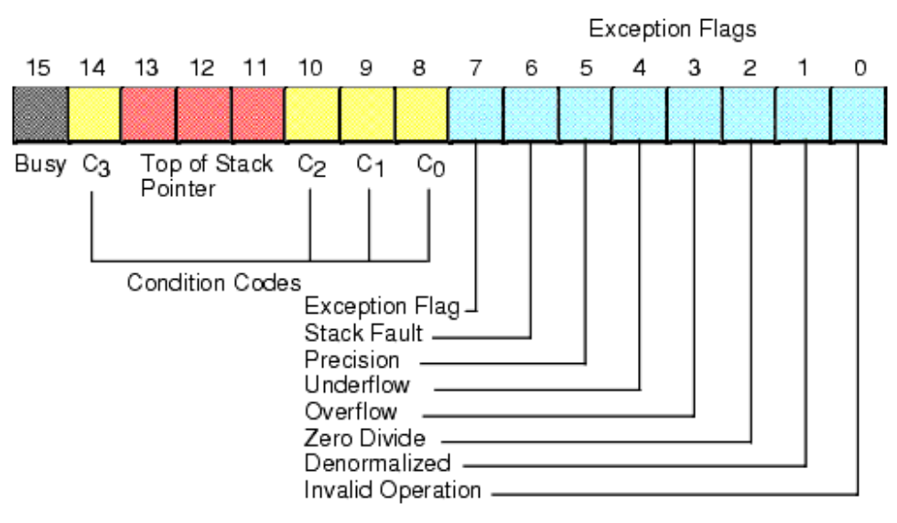
STATUS REGISTER

Slide 14
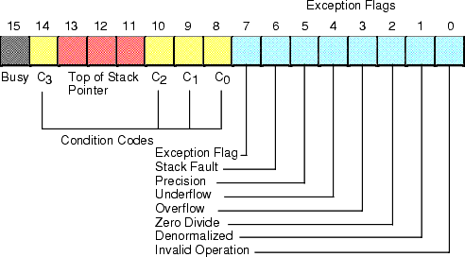
STATUS REGISTER
Status Register tells the overall status of 8087 coprocessor.
It is a 16-bit register.
It is accessed by executing the FSTSW instruction.
This instruction stores the contents of status register into memory.
Once the status is stored in memory, the bit positions of the status register can be examined.
12

Slide 15
STATUS REGISTER
Busy: It indicates that the coprocessor is busy executing the task.
Condition Codes (C₀-C₃): They indicate various conditions about the coprocessor.
Top of Stack: These 3bits used as top of stack pointer to any of the eight stack registers.
Exception Flag: It is set if any of the exception flag bits (SF, PR, UF, OF, ZD, DN, IO) are set.

Slide 16
STATUS REGISTER
Stack Fault: It is not available in 8087. It is active only in 8038 and above.
Precision: It indicates that the result has exceeded the selected precision.
Underflow: It tells if the result is too small to fit in a register.
Overflow: It tells if the result is too large to fit in a register.

Slide 17
STATUS REGISTER
Zero Divide: It indicates that you try to divide a non-zero value by zero.
Denormalized: It indicates that at least one of the operand is de-normalized.
Invalid Operation: It indicates an invalid operation. For e.g.: pushing more than eight items onto the stack, attempting to pop an item off an empty stack or taking the square root of a negative number.

Slide 18
TAG REGISTER
TAG 7 | TAG 6 | TAG 5 | TAG 4 | TAG 3 | TAG 2 | TAG 1 | TAG 0
Tag Values:
00 = Valid
01 = Zero
10 = Invalid
11 = Empty

Slide 19
TAG 7 | TAG 6 | TAG 5 | TAG 4 | TAG 3 | TAG 2 | TAG 1 | TAG 0
Tag Values:
00 = Valid
01 = Zero
10 = Invalid
11 = Empty
Tag Register is used to indicate the contents of each register in the stack.
There are total 8 tags (Tag 0 to Tag 7) in this register and each tag uses 2 bits to represent a value.
Therefore, it is a 16-bit register.
Tag word register present entire TAG field to the CPU.

Slide 20
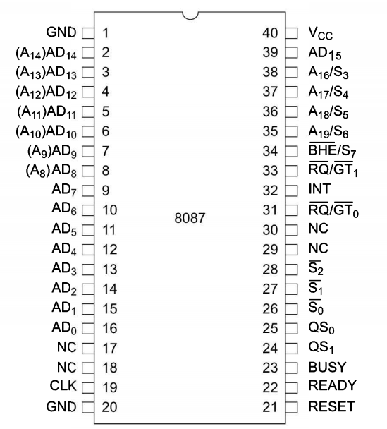
PIN DIAGRAM OF 8087
21

Slide 21
PIN DESCRIPTION
AD0 – AD15 − These are the time multiplexed address/data lines, which carry addresses during the first clock cycle and data from the second clock cycle onwards.
A19/S6 – A16/S3 − These lines are the time multiplexed address/status lines. It functions in a similar way to the corresponding pins of 8086. The S6, S4 and S3 are permanently high, while the S5 is permanently low.
BHE’/S7- used to select data on the higher byte of the 8086 data bus during T1. During T2, T3, Tw and T4 , this signal is a status line S7.

Slide 22
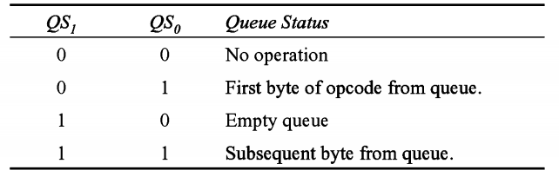
PIN DESCRIPTION
QS₁, QS₀ − These are queue status input signals which provides the status of instruction queue.
INT − It is an interrupt signal, which changes to high when an unmasked exception has been received during the execution.
BUSY − It is an output signal, when it is high it indicates a busy state to the CPU. It is connected to TEST’ pin of 8086.
READY − It is an input signal used to inform the coprocessor whether the bus is ready to receive data or not.

Slide 23
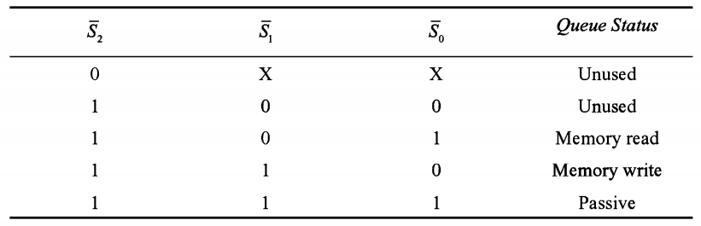
PIN DESCRIPTION
S’₀, S’₁, S’₂ − These are the status signals that provide the status of the operation which is used by the Bus Controller 8087 to generate memory and I/O control signals. These signals are active during the fourth clock cycle.
RQ’/GT’₁ & RQ’/GT’₀ − These are the Request/Grant signals used by the 8087 processors to gain control of the bus from the host processor 8086/8088 for operand transfers.

Slide 24
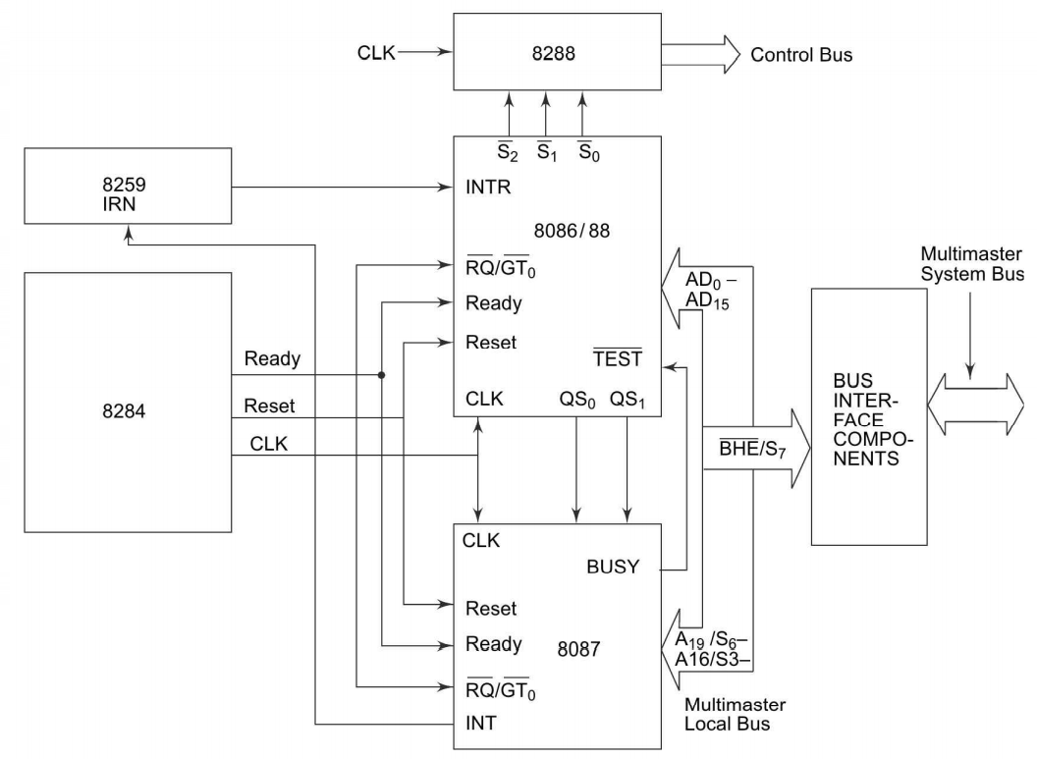
INTERFACING 8087 with 8086/8088

Slide 25
INTERFACING 8087 with 8086/8088
8087 can be connected with CPU only in max.mode, i.e when MN/MX pin is grounded.
In max. mode, all control signals are derived using a 8288 bus controller.
Multiplexed address-data bus lines are connected directly from the 8086 to 8087.
The status lines and the queue status lines connected directly from 8086 to 8087.
The QS0 and QS1 lines may be directly connected to corresponding pins in case of 8086/88 based systems.

Slide 26
INTERFACING 8087 with 8086/8088
The Request/Grant signal RQ/GT0 of 8087 is connected to RQ/GT1 of 8086.
The clock pin of 8087 connected with CPU 8086/88 clock i/p.
The interrupt o/p of 8087 is routed to 8086/88 via a programmable interrupt controller.
The pins AD0-AD15,BHE/S7,RESET,A19/S6-A16/S3 are connected to corresponding pins of 8086
BUSY signal 8087 is connected to TEST pin of 8086

Slide 27
INSTRUCTION SET 8087
The 8087 co-processor has 68 additional instructions to the instruction set of 8086.
These instructions are fetched by 8086 but are executed by 8087.
The execution of 8087 instructions is transparent to the programmer.
When the 8086 comes across an 8087 instruction, it executes the ESCAPE instruction code to bypass the instruction opcode and control of the local bus to 8087 co-processor.

Slide 28
8087 INSTRUCTION TYPES
Data Transfer
Arithmetic
Comparison
Transcendental
Constant
Coprocessor control

Slide 29
Data Transfer Instructions
Floating Point Data Transfer
Integer Data Transfer
BCD Data Transfer

Slide 30

Floating Point Data Transfer Instructions
FLD(Load Real)
Loads 80-bit floating-point data to Top of Stack (ST). Stack pointer is then decremented by 1. Data can be retrieved from memory, or another stack register.
Examples :

Slide 31

FST (Store real)
This instruction stores current content of the top of the stack into memory or a specified co-processor register.
During copy, the data rounding occurs using the rounding control bits in floating point control register.
Examples :

Slide 32


FSTP (Store floating point number and pop)
This instruction stores a copy of the top of the stack into memory or any specified co-processor register and pop the data from the top of stack.
Examples
FXCH Exchange
The FXCH instruction exchanges the contents of specified register with top of stack.
Examples:

Slide 33
Integer Data Transfer Instructions
FILD (Load integer)
FIST (Store integer)
FISTP (Store integer and pop)

Slide 34
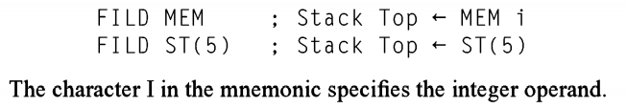
FILD (Load integer)
loads the specified integer data operand to the top of the stack.
FIST (Store integer) and FISTP (Store integer and pop):
The instructions FIST and FISTP work in an exactly similar manner as FST/FSTP except that the operands are integer operands.

Slide 35
BCD Data Transfer Instructions
The 8087 has two BCD data transfer instructions
FBLD (loads the top of stack with BCD memory data), and FBSTP (stores top of the stack and does a pop).
Both the instructions work in an exactly similar manner as FLD and FSTP except that the operands are BCD numbers.

Slide 36
Arithmetic Instructions
1. Addition
FADD Add real
FADDP Add real and pop
FIADD Add integer
These two instructions perform real or integer addition of the specified operand with the stack top.
After addition, the results are stored in the destination operand.
The operand may be any of the stack registers or a memory location.

Slide 37
2. Subtraction
FSUB Subtract real
FSUBP Subtract real and pop
FISUB Subtract integer
FSUBR Subtract real reversed
FSUBRP Subtract real and pop
FISUBR Subtract integer reversed
These instructions perform real or integer subtraction of the specified operand from the stack top.
The operand may be any of the stack register or memory.
After subtraction, the result of the operation is stored in the destination operand.

Slide 38
Arithmetic Instructions
3. Multiplication
FMUL Multiply real
FMULP Multiply real and pop
FIMUL Multiply integer
These two instructions perform real or integer multiplication of the specified operand with stack top.
The specified operand may be a register or a memory location.
After multiplication, the result will be stored in the destination operand.

Slide 39
Arithmetic Instructions
4. Division
FDIV Multiply real
FDIVP Multiply real and pop
FDIVR Multiply integer
FDIVRP
These four instructions perform real or integer division.
When the destination is not specified, the top of stack is the destination operand and source operand may be a memory operand of short real or long real type.
If both destination and source operands are specified then compute the division and store the result in the destination.

Slide 40
Arithmetic Instructions
5. Advanced
FABS : This instructions replaces the content of stack top by its absolute value.
FCHS: This instruction changes the sign of the content of stack top.
FPREM: divides the stack top (ST) by ST(1)and then store the remainder to the stack top (ST).
FPRNDINT: rounds the content of ST(0) to its integer value.

Slide 41

FSCAL: multiplies the content of stack top (ST) by 2n, where n is integer part of ST(1) and store result in ST.
FSQRT: finds out the square root of the content of the stack top and stores the result on stack top again.
FXTRACT: extracts the exponent and fraction of stack top and stores them in stack of registers.
Note:

Slide 42
Comparison Instructions.
FCOM Compare real
FCOMP Compare real and pop
FCOMPP Compare real and pop twice
FICOM Compare integer
FICOMP Compare integer and pop
FIST Test ST is zero
FXAM Examine ST
The comparison instructions of the 8087 co-processor are used to compare the two values on the top of stack and set the condition code flags appropriately.

Slide 43

Transcendental Instructions
FPTAN Partial tangent
used to compute the partial tangent of an angle , where must be in the range 0° . The value of angle must be stored at the stack top. The result is computed in the form of a ratio of ST/ST(1).
FPATAN Partial arc tangent
The FPATAN instruction calculates the are tangent (inverse tangent) of a ratio ST(1)/ST(0). The stack is popped and the result is stored on the top of stack. Its function can be expressed as

Slide 44
F2XM1
Calculates the expression (2x-1). The value of x is stored at the top of the stack.
FYL2X
FYL2XP1

Slide 45
Constant Instructions.
FLDZ Load +0.0
FLDI Load+1.0
FLDPI Load π
FLDL2T Load log210
FLDL2E Load log2e
FLDLG2 Load log102
FLDLN2 Load loge2
These instructions load the specific constants to the top of the register stack. Stack top is an implicit operand in all instructions

Slide 46
CO-PROCESSOR CONTROL INSTRUCTIONS
used to program the numeric processor or to handle the internal functions like flags manipulations, exception handling, processor environment maintenance and preparation, etc.

Slide 48
ALP Programming with 8087
Write a program to add three numbers and store the result.
Program
finit → Initialize the coprocessor to start at the beginning of the stack
fld X → Load X into ST(0); ST(0) = X
fld Y → ST(0) = Y, ST(1) = X
fld Z → ST(0) = Z, ST(1) = Y, ST(2) = Z
fadd ST(1) → Add Y and Z and store the result in ST(0)
fadd ST(2) → Add X and Y+Z and store the result in ST(0)
fst sum → Store the added result in the memory location named ‘sum’

Slide 49
